Slide 1
Optical Flow Estimation Based Deep Learning Approaches
Joseph Afriyie Attakorah

Slide 2
SUBJECT AREA
Images have spatial characteristics
Videos have specific temporal resolution characteristics i.e. frame per second (fps)
Optical flow is the pattern of apparent motion of an object in a visual scene caused by the relative motion between an observer and the scene.
Pattern of movement of pixel brightness across the screen over time
Computer Vision technique

Slide 3
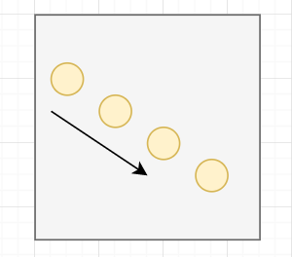
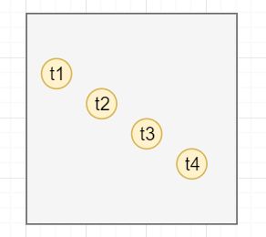
Optical Flow

Slide 4
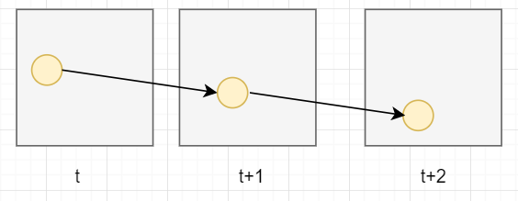
Optical Flow
Video Frames

Slide 5
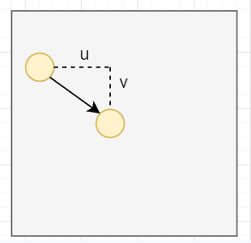
Optical Flow Estimation
The problem of optical flow

Slide 6
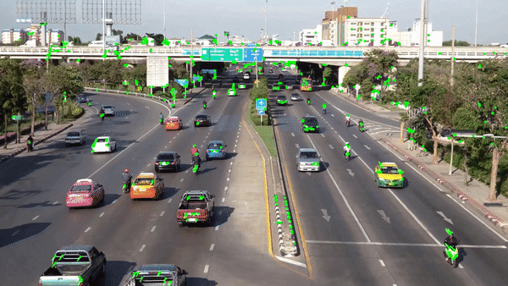
Scene

Slide 7
Optical Flow problem
The problem of optical flow has historically been an optimization problem in computer vision
Recent approaches by applying deep learning have shown impressive results. Generally, such approaches take two video frames as input to output the optical flow.

Slide 8
Deep Learning
Deep learning is part of a broader family of machine learning methods based on artificial neural networks that uses multiple layers to progressively extract higher level features from the raw input. For example, in image processing, lower layers may identify edges, while higher layers may identify the concepts relevant to a human such as digits or letters or faces. Learning can be supervised, semi-supervised or unsupervised. Wikipedia

Slide 9
Per-Pixel Estimation (Optical Flow)
With the recent advancements in AI, Deep nets are becoming a popular approach to solving problems. In this project, we try to achieve an algorithm that prioritizes motion as a key characteristic of classification and is computationally feasible within the real-world context. The best possible way is through optical flow.

Slide 10
Deep Nets
FlowNetS
FlowNetC
FlowNet2.0
PWC-Net

Slide 11
Solution Approach and Tasks
Review related works on optical flow
Understand the dataset which contains images for training.
Use deep learning approaches and TensorFlow library to generate a model which would be able to produce effective optical flow for a given input sequence of raw images.
Test the accuracy by comparing the produced optical flow with ground truth.

Slide 12
References
https://medium.com/swlh/what-is-optical-flow-and-why-does-it-matter-in-deep-learning-b3278bb205b5
https://medium.com/swlh/what-is-optical-flow-and-why-does-it-matter-in-deep-learning-b3278bb205b5
https://nanonets.com/blog/optical-flow/

Slide 13
Thank you!

